Slide 1
Mobile Apps Distribution Platforms
Presented by : Er. Basanr kumar yadav

Slide 2
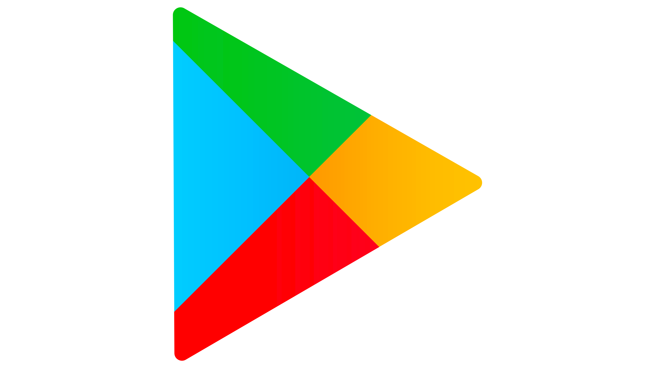
Introduction to Mobile Apps Distribution Platforms
A platform commonly known as an app store where developers publish apps and users install, update, and review them..
These platforms handle distribution, updates, monetization, and often enforce security and quality standards.
These platforms often include developer tools, analytics, monetization options, and security vetting.
1
Notes:
Image source: https://purepng.com

Slide 3
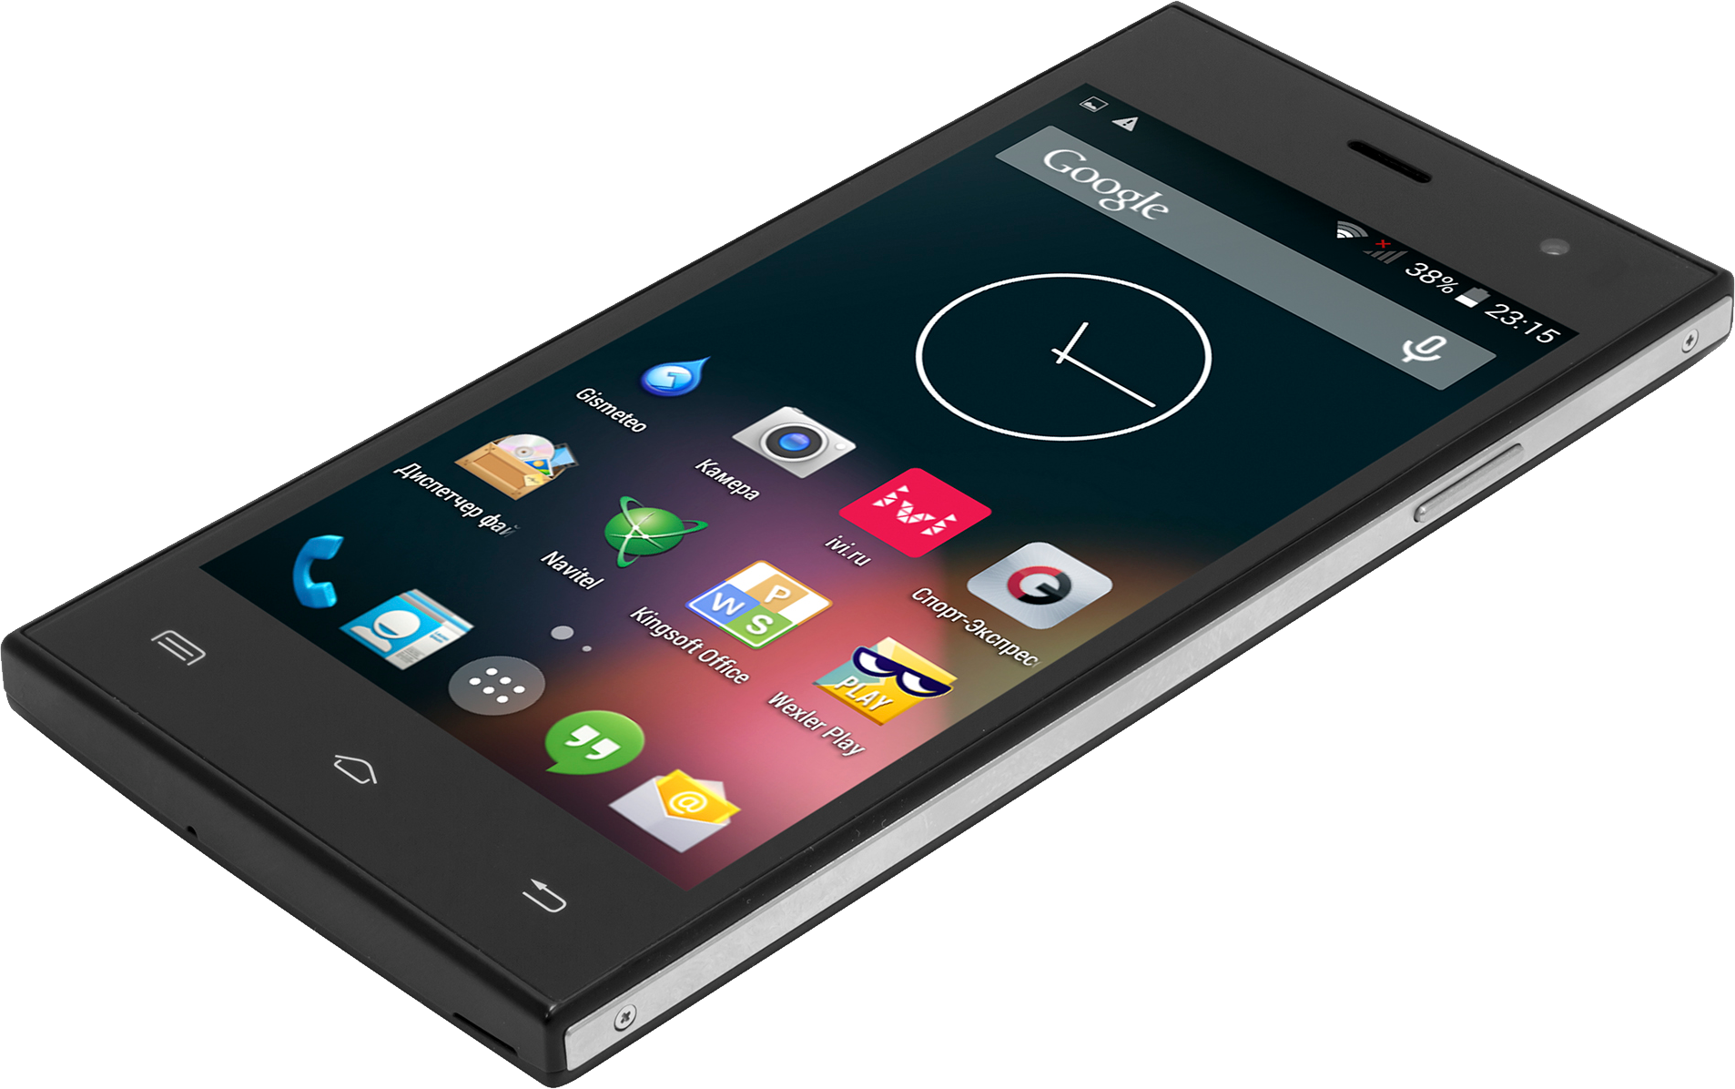
Major Mobile App Stores Overview
Google Play Store
App store
Samsung Galaxy Store
Huawei App Gallery
Amazon App store
2
Notes:
Image source: https://purepng.com

Slide 4
1.Google Play Store
The Google Play Store is the official app distribution platform for Android devices.
It allows users to download free and paid apps, games, books, and movies.
Developers must register for a Google Play Developer Account (with a one-time fee) to publish apps.
Features include in-app purchases, subscriptions, app ratings, reviews, and automatic updates.
Security is managed through Google Play Protect, which scans apps for malware.
3
Notes:
Image source: https://purepng.com

Slide 5
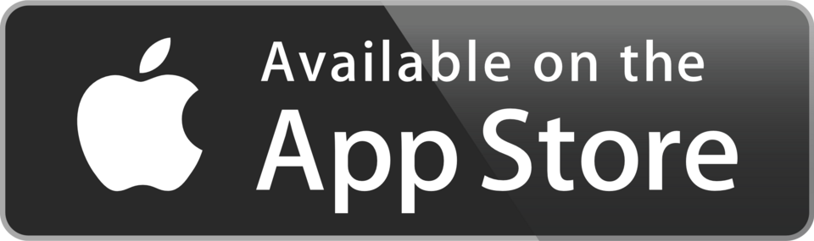
2.Apple App Store
The Apple App Store is the official marketplace for iOS devices (iPhone, iPad, iPod Touch).
Developers need an Apple Developer Program membership (annual fee) to distribute apps.
All apps undergo a strict review process to ensure quality, performance, and security.
Supports in-app purchases, subscriptions, and monetization options for developers.
Known for high user trust and a large global customer base.
4
Notes:
Image source: https://purepng.com

Slide 6
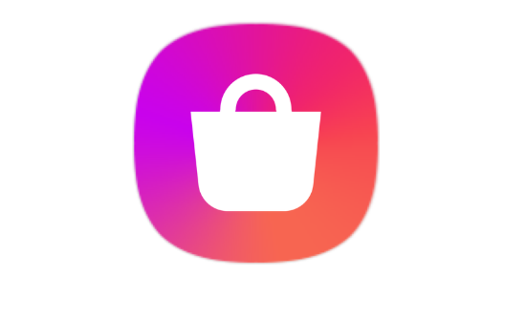
3.Samsung Galaxy Store
The Samsung Galaxy Store is designed specifically for Samsung devices.
Offers apps, games, themes, and watch faces optimized for Galaxy smartphones, tablets, and smart watches.
Developers can target Samsung device users with custom features like S-Pen, foldable screens, and Galaxy Watch apps.
Often used for exclusive Samsung apps and promotions.
5
Notes:
Image source: https://purepng.com

Slide 7

4.Huawei App Gallery
The Huawei App Gallery is Huawei’s official app distribution platform.
It became popular after Huawei lost access to Google Play Services.
Available globally on Huawei and Honor devices.
Provides categories for apps, games, and local content, with strong security verification.
Developers can integrate with Huawei Mobile Services (HMS) for analytics, ads, and push notifications.
6
Notes:
Image source: https://purepng.com

Slide 8
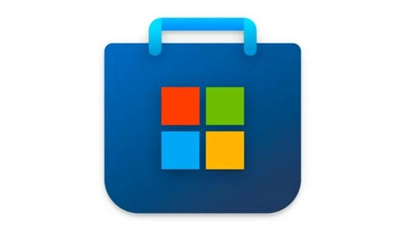
5.Microsoft Store (for Mobile & Windows Apps)
Although Windows Phone is discontinued, the Microsoft Store still distributes apps for Windows PCs, tablets, and Surface Duo.
It supports UWP (Universal Windows Platform) apps, Android apps (on Windows 11 via Amazon Appstore), and some mobile productivity tools.
Developers can monetize apps via subscriptions, in-app purchases, and ads.
7
Notes:
Image source: https://purepng.com

Slide 9

Conclusion
Mobile app distribution is becoming more flexible and competitive. While Google Play and Apple App Store still lead, new entrants and legal rulings are tearing down barriers for developers and users alike
10
Notes:
Image source: https://purepng.com

